Slide 1


Group 2
UCCD 1033
Diabetes Prediction Using Logistic Regression
Group 2:
Loh Chia Heung 2301684
Tong Yu Shan 2301157
Low Jia Hao 2302161
Google Drive Link:
https://drive.google.com/file/d/1amUTSgoTVY71096r6BDWtVFztbU2ycuK/view?usp=sharing

Slide 2

Group 2
Table of Contents
Chapter 1 – Introduction
Chapter 2 – Literature Review
Chapter 3 – Machine Learning Model Development Process
Chapter 4 - Results, Analysis, Findings & Conclusion
01
02

Slide 3

Group 2
Introduction & Motivation
Type 2 diabetes is rising globally
Many cases undiagnosed until late stage
Early detection can prevent complications
ML offers fast, low-cost risk assessment
01
02
Presented By: Low Jia Hao 2302161

Slide 4

Group 2
Problem Statement
01
Screening relies on costly lab tests
High-risk individuals often overlooked
Need for an automated, interpretable tool
02
Presented By: Low Jia Hao 2302161

Slide 5
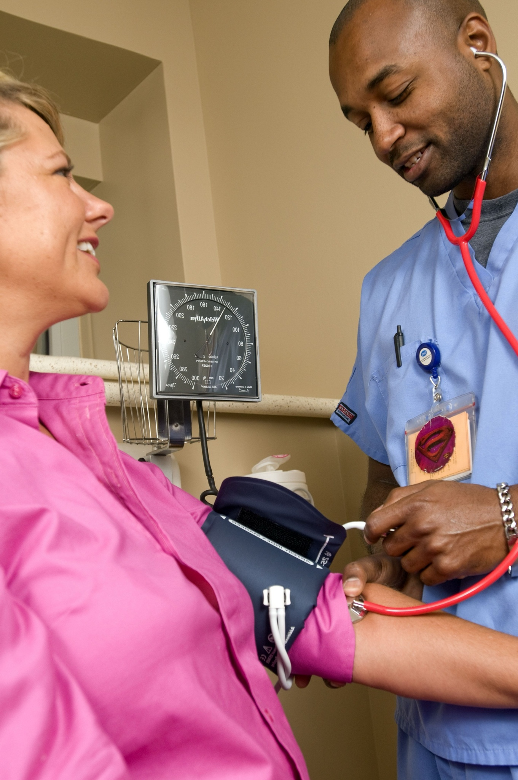
Group 2
Project Scope
01
• Data: Pima Indian Diabetes (tabular)
• Focus: Adult type 2 diabetes, binary classification
• Includes: preprocessing, modeling, evaluation
• Excludes: longitudinal forecasts, deep learning, deployment
02
Presented By: Low Jia Hao 2302161

Slide 6
Group 2
Problem Objective
Clean and balance the dataset
Train logistic regression, random forest, SVM
Evaluate: accuracy, precision, recall, F1, ROC-AUC
Deliver a transparent, reproducible pipeline
01
02
Presented By: Low Jia Hao 2302161

Slide 7
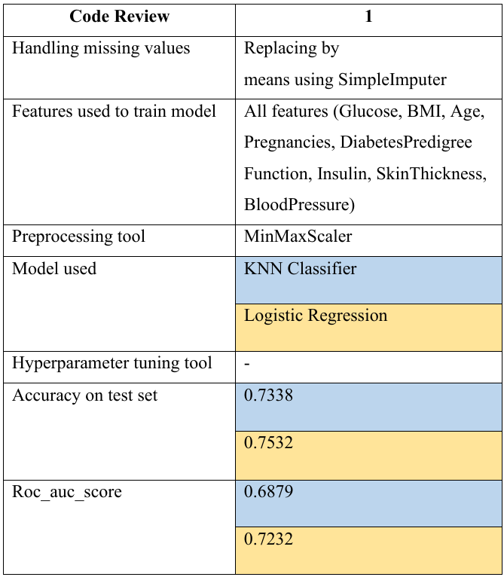
Presented By: Tong Yu Shan 2301157
Group 2
Chapter 2 – Literature Review
- Code Review 1
[1]
KNN < LR
No data
exploration
No data
visualization
LIMITATION
Without hyperparameter tunning
[1] Code Review 1: https://www.kaggle.com/datasets/uciml/pima-indians-diabetes-database

Slide 8
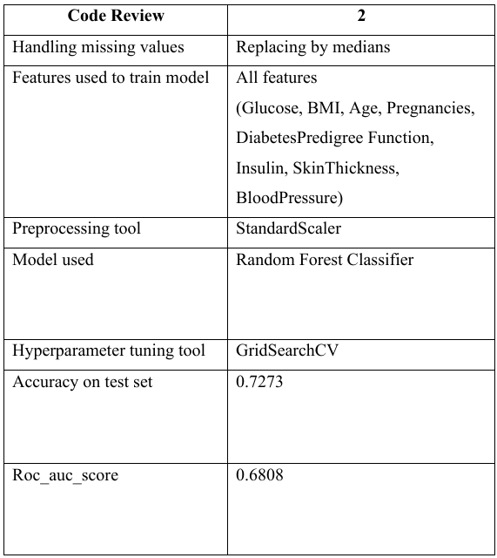
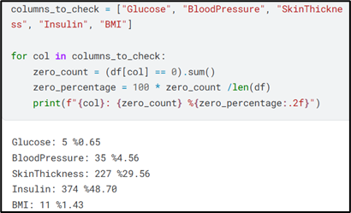
Presented By: Tong Yu Shan 2301157
Group 2
Chapter 2 – Literature Review
- Code Review 2
[2]
LIMITATION
Less data
visualization
Unideal data preprocessing
[2] Code Review 2: https://www.kaggle.com/code/alperaydoan/pima-indians-diabetes-database-with-randomforest

Slide 9
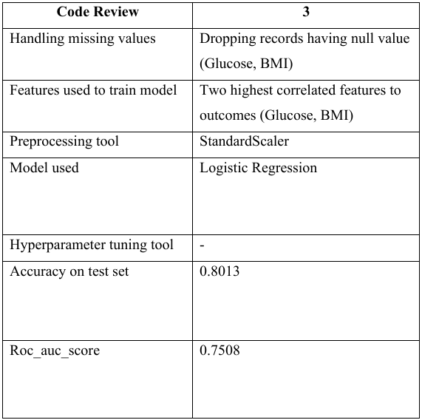
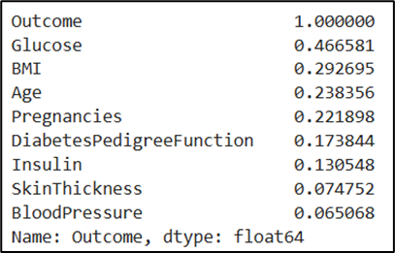
Presented By: Tong Yu Shan 2301157
Group 2
Chapter 2 – Literature Review
- Code Review 3
[3]
LIMITATION
Ignore more predictive features in combination
Oversimplify
the relationship
[3] Code Review 3: https://www.kaggle.com/code/mshirlaw/pima-indians-diabetes-simple-logistic-regression

Slide 10
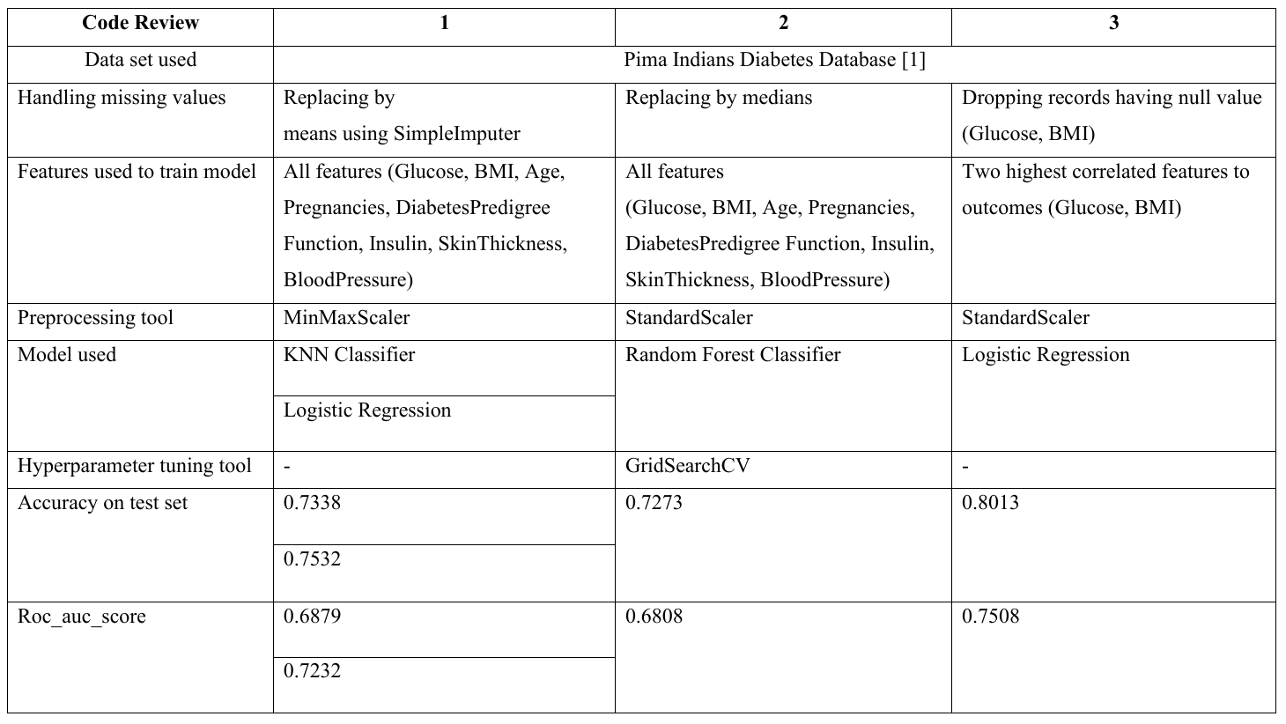
Presented By: Tong Yu Shan 2301157
Group 2
Chapter 2 – Literature Review
- Comparison
0.8013
0.7508
[1] Kaggle Link: https://www.kaggle.com/datasets/uciml/pima-indians-diabetes-database

Slide 11
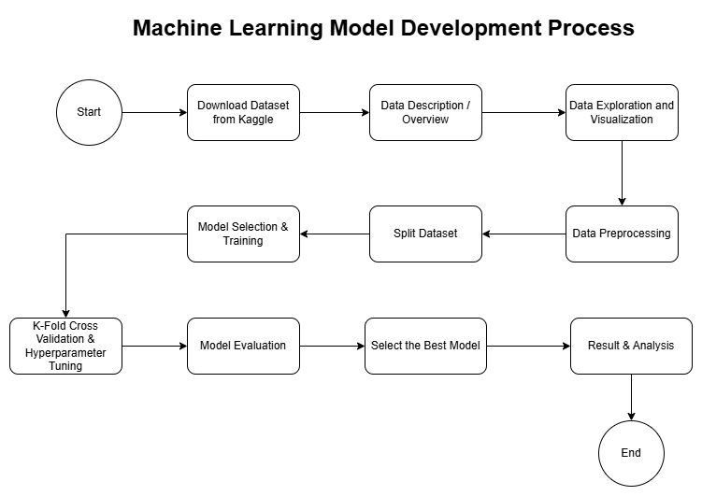
Group 2
Chapter 3 – ML Model Development Process
Machine Learning Model Development Process
Step 1: Dataset Acquisition
Step 2: Data Exploration
Step 3: Data Preprocessing & Train/Test Split
Step 4: Model Selection (LR, SVM, RF)
Step 5: Cross-validation & Hyperparameter tuning
Step 6: Model Evaluation & Best Model Selection (Chapter 4)
Presented By: Loh Chia Heung 2301684

Slide 12
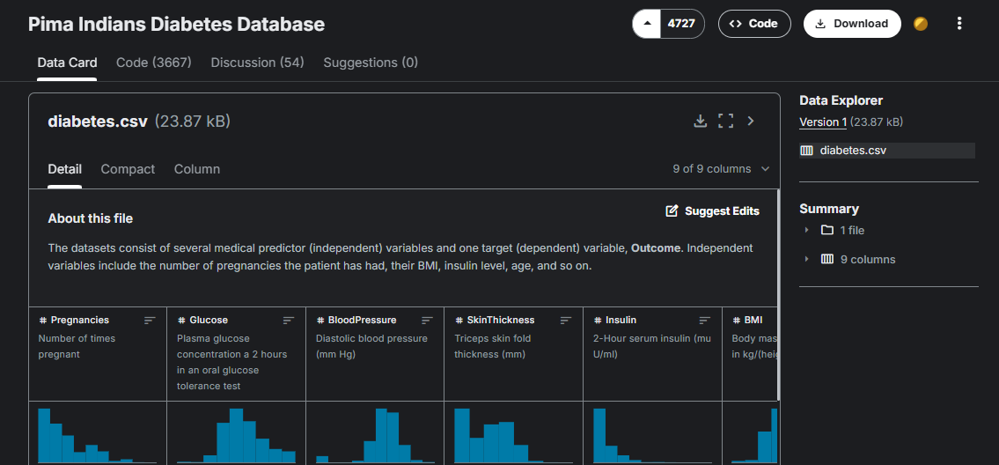
Group 2
Chapter 3 – ML Model Development Process
Step 1 – Dataset Acquisition
Source: Kaggle Repository
Format: CSV file with 768 records
Target Variable: Outcome (1 = diabetic, 0 = non-diabetic)
Reason Chosen: Widely used in medical ML research, reproducible and open-source (public) dataset
Kaggle Link: https://www.kaggle.com/datasets/uciml/pima-indians-diabetes-database
Presented By: Loh Chia Heung 2301684

Slide 13
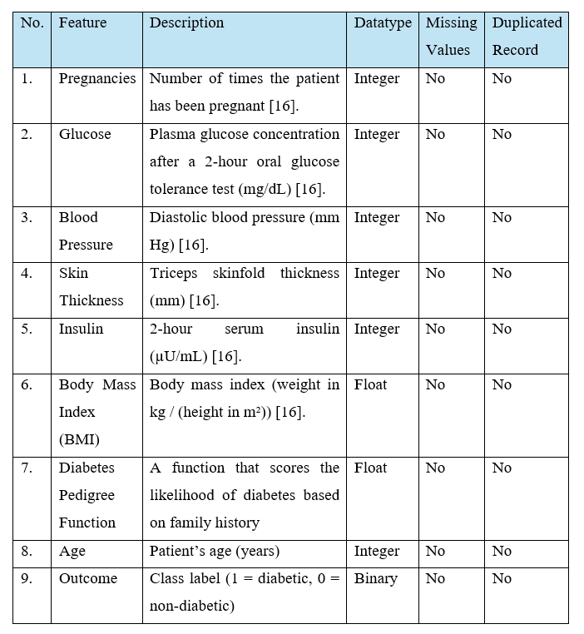
Group 2
Chapter 3 – ML Model Development Process
Step 2 – Dataset Description
8 Features + 1 Outcome
Independent Features includes (8): Pregnancies, Glucose, Blood Pressure, Skin Thickness, Insulin, Body Mass Index (BMI), Diabetes Pedigree Function, Age
All values are numeric (int + float)
Dependent Variable: Outcome is binary (0 – Non-diabetic, 1 = diabetic)
Presented By: Loh Chia Heung 2301684

Slide 14
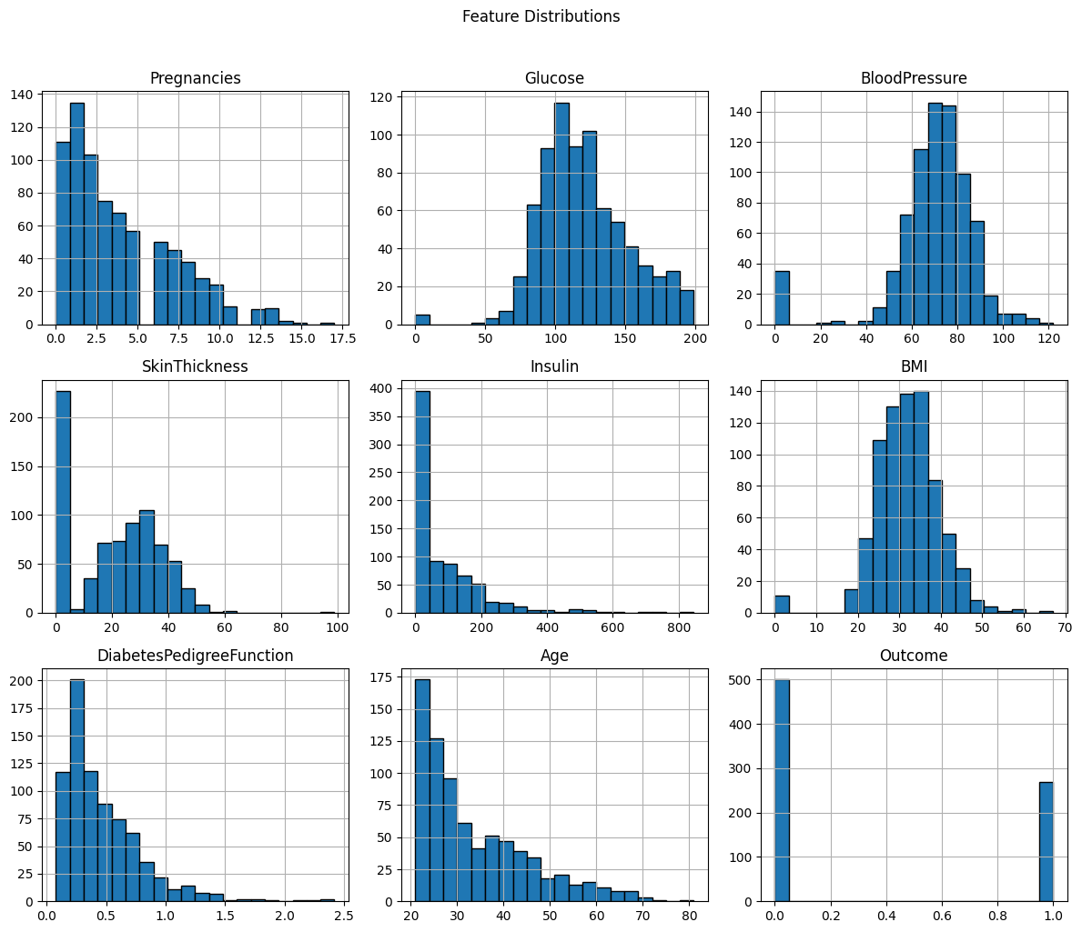
Group 2
Chapter 3 – ML Model Development Process
Step 2 – Dataset Exploration (EDA) – Feature Distribution
Features shows different distribution shapes.
Insulin & Skin Thickness are highly skewed toward the lower values.
Age & BMI is more normal like distribution
Recognizing skewness is important for scaling and model sensitivity.
Presented By: Loh Chia Heung 2301684

Slide 15
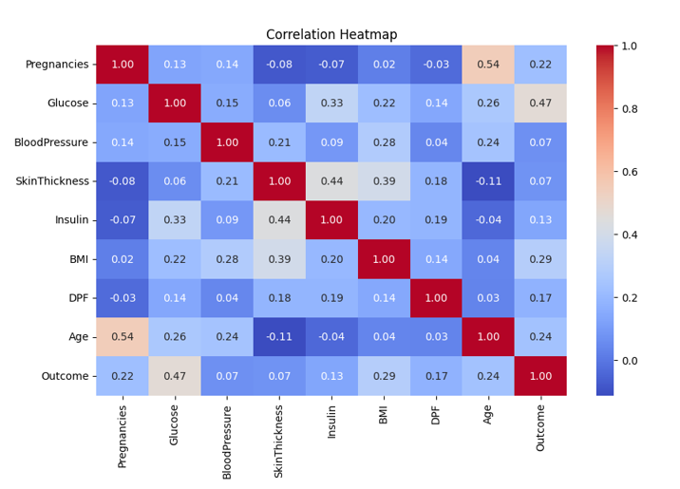
Group 2
Chapter 3 – ML Model Development Process
Step 2 – Dataset Exploration (EDA) – Correlation Analysis
Glucose shows strongest positive correlation with diabetes outcome.
BMI & Age also moderately correlated with outcome.
Other features (Skin Thickness, Insulin) show weak direct correlation.
Helps identify most predictive features.
Presented By: Loh Chia Heung 2301684

Slide 16
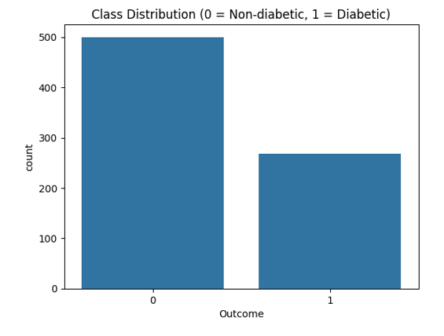
Group 2
Chapter 3 – ML Model Development Process
Step 2 – Dataset Exploration (EDA) – Class Distribution
Outcome variable distribution:
500 non-diabetic (65%)
268 diabetic (35%)
Moderately imbalanced dataset.
Accuracy alone is not enough → must use ROC-AUC, Precision, Recall.
Presented By: Loh Chia Heung 2301684

Slide 17
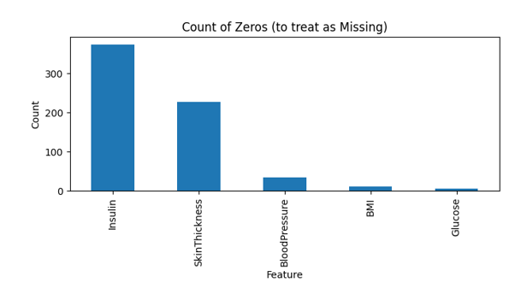
Group 2
Chapter 3 – ML Model Development Process
Step 3 – Dataset Preprocessing – Handling Zero Values
Several medical features contain zeros, which are biologically invalid:
Glucose, Blood Pressure, BMI, Skin Thickness, Insulin
Step 1: Zeros in Glucose and BMI were placed with NaN, then dropped.
Removed invalid records.
However, it reduced the dataset size.
Other features are handled later with imputation.
Presented By: Loh Chia Heung 2301684

Slide 18
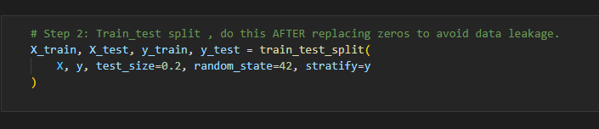
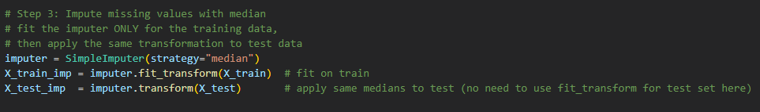
Group 2
Chapter 3 – ML Model Development Process
Step 3 – Dataset Preprocessing – Imputation & Data Splitting
Train/Test split: 80% training, 20% testing.
Stratified split : Maintains ratio of diabetic vs non-diabetic.
Step 2 (Final Approach):
Zeros in Blood Pressure, Skin Thickness, and Insulin replaced with NaN
Median Imputation applied to fill missing values → robust against skewed data.
Avoided data leakage by fitting imputer only on training set.
Presented By: Loh Chia Heung 2301684

Slide 19
Group 2
Chapter 3 – ML Model Development Process
Step 4 – Model Selection
3 supervised learning models selected:
Logistic Regression (LR): Linear, interpretable baseline
Support Vector Machine (SVM): Captures nonlinear relationships
Random Forest (RF): Ensemble method, robust & handles feature interactions
Same training protocol applied for fairness
Pipelines used to embed preprocessing into each model
Model | Type | Key Strength
1. Logistic Regression (LR) | Linear | Easy to interpret.
2. Support Vector Machine (SVM) | Kernel-based | Captures non-linear boundaries
3. Random Forest (RF) | Ensemble | Robust, feature important
Presented By: Loh Chia Heung 2301684

Slide 20
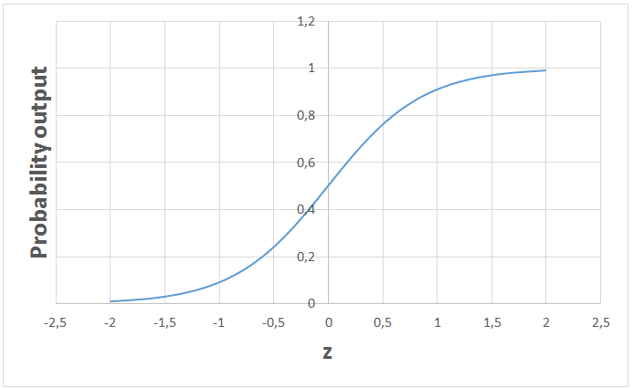
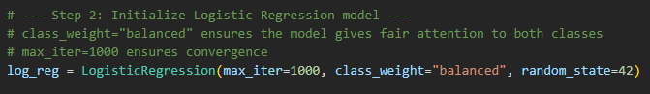
Group 2
Chapter 3 – ML Model Development Process
Step 4 – Model Selection – Logistic Regression (LR)
Widely used in medical applications (probability-based prediction)
Interpretable: coefficients show feature importance
Settings:
class_weight="balanced" → handle class imbalance
max_iter=1000 → ensure convergence
Baseline linear model for comparison
Provides probability outputs → Useful for ROC-AUC
Presented By: Loh Chia Heung 2301684

Slide 21
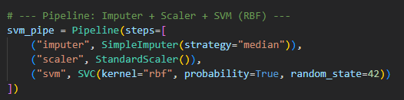
Group 2
Chapter 3 – ML Model Development Process
Step 4 – Model Selection – Support Vector Machine (SVM)
Captures non-linear relationships using RBF kernel
Effective in high-dimensional feature space
Provides probability estimates for ROC–AUC evaluation
Settings:
kernel="rbf“
probability=True
random_state=42
Presented By: Loh Chia Heung 2301684

Slide 22
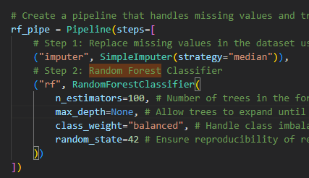
Group 2
Chapter 3 – ML Model Development Process
Step 4 – Model Selection – Random Forest (RF)
Ensemble method combining many decision trees
Handles feature interactions & non-linearities well
Provides feature importance ranking
Robust to noise and overfitting compared to single decision trees
Settings:
n_estimators = 100
Max_depth = None
class_weight="balanced“
random_state=42
Presented By: Loh Chia Heung 2301684

Slide 23
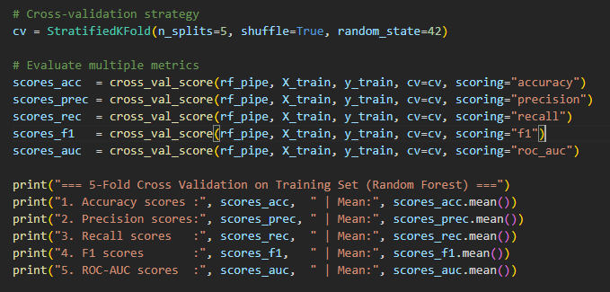
Group 2
Chapter 3 – ML Model Development Process
Step 5 – Model Training - Cross-Validation
Used 5-fold stratified cross-validation on training set.
Ensures class ratio (diabetic vs non-diabetic) remains balanced in each fold
Each model trained on 4 folds, validated on 1-fold → repeated 5 times
Final score = average performance across folds
Reduces risk of overfitting and gives reliable estimate of generalization
Presented By: Loh Chia Heung 2301684

Slide 24
Group 2
Chapter 3 – ML Model Development Process
Step 5 – Model Optimization – Hyperparameter Tuning
Model | Key Params Tuned | Example Values
1. Logistic Regression (LR) | C, Penalty, Solver | {0.01, 0.1, 1, 10}, {l1, l2}, {liblinear, saga}
2. Support Vector Machine (SVM) | C, Kernel, Gamma | {0.1, 1, 10}, {linear, rbf}, {scale, auto}
3. Random Forest (RF) | n_estimators, max_depth, max_samples_split, min_samples_leaf, max_features | {100, 300}, {5, 10}, {2, 5}, {1, 2}, {sqrt, log2}
Used GridSearchCV together with cross-validation
Explored different parameter combinations for each model
Primary metric: ROC–AUC (better than accuracy for imbalanced data)
Best parameter set selected for final training
Presented By: Loh Chia Heung 2301684

Slide 25
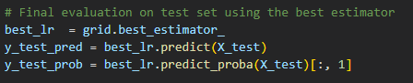
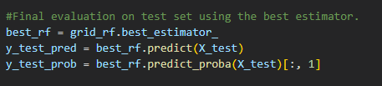
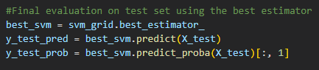
Group 2
Chapter 3 – ML Model Development Process
Step 5 – Final Training Protocol & Evaluation
Retrain each best-tuned model (LR, SVM, RF) on the full training set
Evaluate on the unseen 20% test set
Multiple metrics used for fair comparison:
Accuracy, Precision, Recall, F1-Score
Confusion Matrix
ROC–AUC & Precision–Recall curves
Results are presented in Chapter 4
Presented By: Loh Chia Heung 2301684

Slide 26
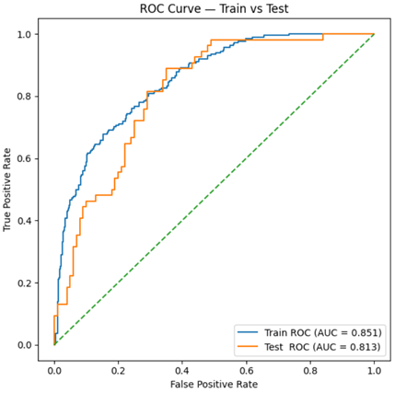
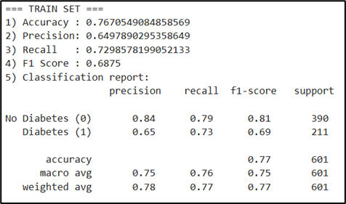
Group 2
Chapter 4 – Results, Analysis, Findings & Conclusion
4.1 Logistic Regression (LR) Results – Baseline Train: Train Set
Accuracy: 76.7%
Precision: 65.0% | Recall: 73.0% | F1-score: 68.8%
ROC–AUC: 0.841
Moderate performance on training set
Recall > Precision → Better at identifying non-diabetes cases
Presented By: Tong Yu Shan 2301157

Slide 27
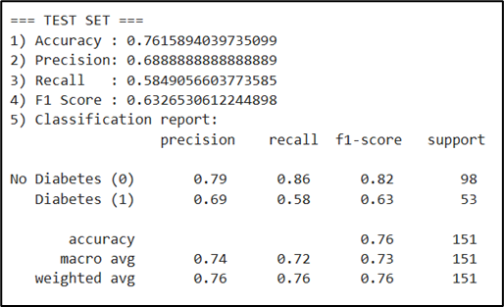
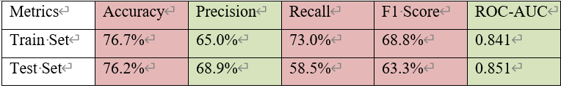
Group 2
Chapter 4 – Results, Analysis, Findings & Conclusion
4.1 Logistic Regression (LR) Results – Baseline Train: Test Set
Accuracy: 76.2%
Precision: 68.9% | Recall: 58.5% | F1-score: 63.3%
ROC–AUC: 0.851
Moderate performance
Recall > Precision → Better at identifying diabetes cases
Similar accuracy and ROC-AUC Score →No overfitting
Presented By: Tong Yu Shan 2301157

Slide 28
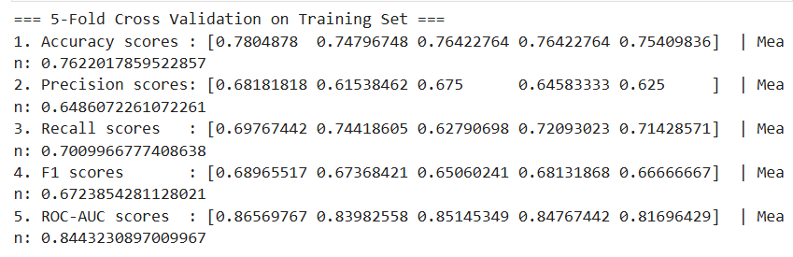
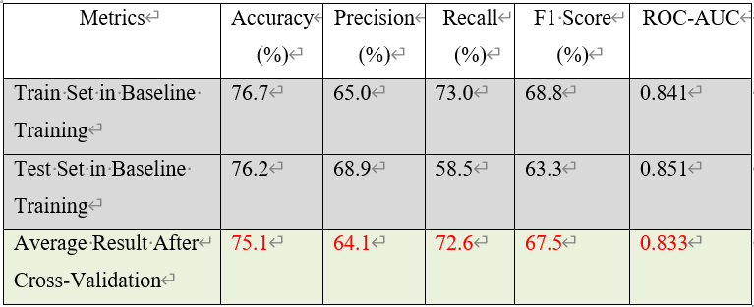
Group 2
Chapter 4 – Results, Analysis, Findings & Conclusion
4.1 Logistic Regression (LR) Results – Cross Validation: Train Set
Mean value:
Accuracy: 75.1%
Precision: 64.1% | Recall: 72.6% | F1-score: 67.5%
ROC–AUC: 0.834
Cross-validation gives more robust estimate and reliable metric
Confirms model can perform reliable and stable performance
Presented By: Tong Yu Shan 2301157

Slide 29
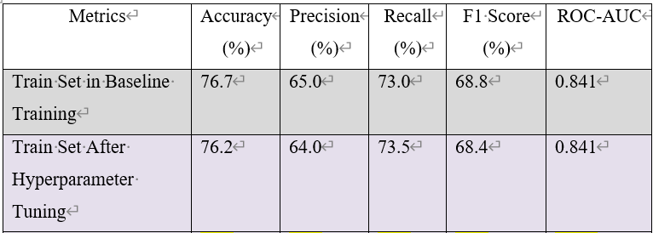
Group 2
Chapter 4 – Results, Analysis, Findings & Conclusion
4.1 Logistic Regression (LR) Results – Hyperparameter Tuning: Training Set
Accuracy: 76.2%
Precision: 64.6% | Recall: 72.4% | F1-score: 68.3%
ROC–AUC: 0.841
Model’s performance is almost the same as baseline
Didn’t lead to overfitting
Didn’t boost learning power significantly
Best Parameters (GridSearchCV):
C: {0.1}
penalty: {l2}
solver: {liblinear}
Presented By: Tong Yu Shan 2301157

Slide 30
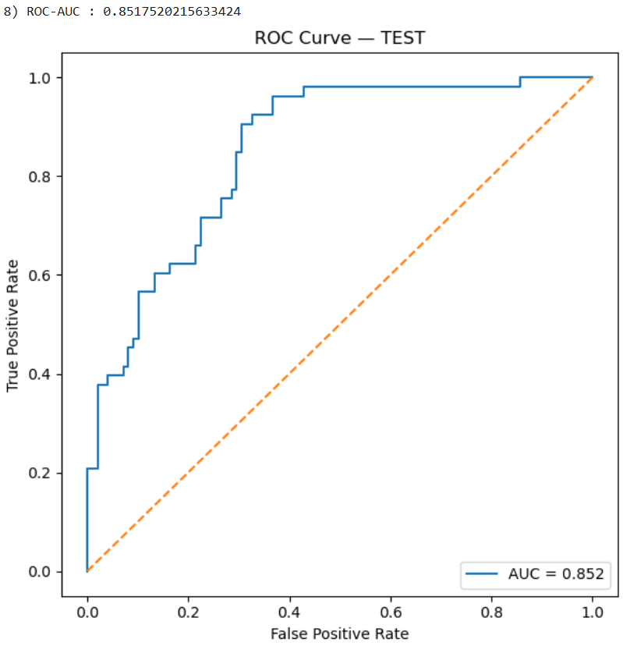
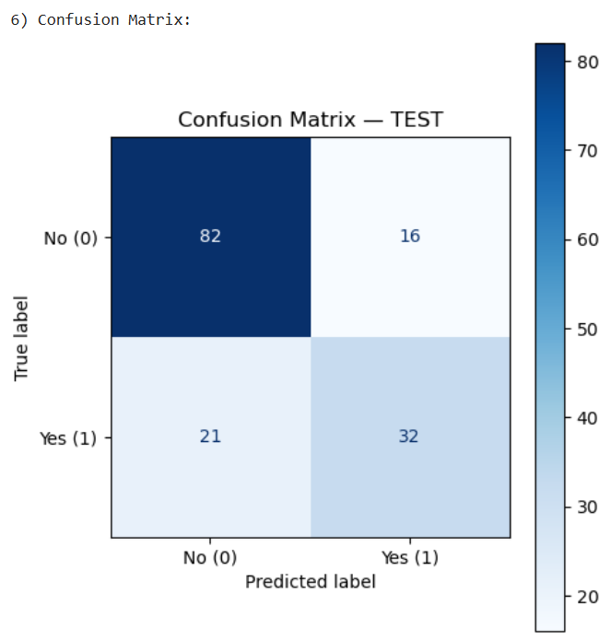
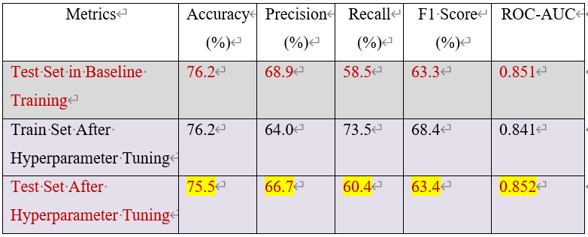
Group 2
Chapter 4 – Results, Analysis, Findings & Conclusion
4.1 Logistic Regression (LR) Results – Hyperparameter Tuning: Test Set
Accuracy: 75.5%
Precision: 66.7% | Recall: 60.4% | F1-score: 63.4%
ROC–AUC: 0.852
Model is stable, no overfitting
Classify well between diabetes and non-diabetes
WHY?
LR separate classes with a straight line
In baseline training, class_weight = “balanced” is applied, no much left for tuning to optimize
Presented By: Tong Yu Shan 2301157

Slide 31
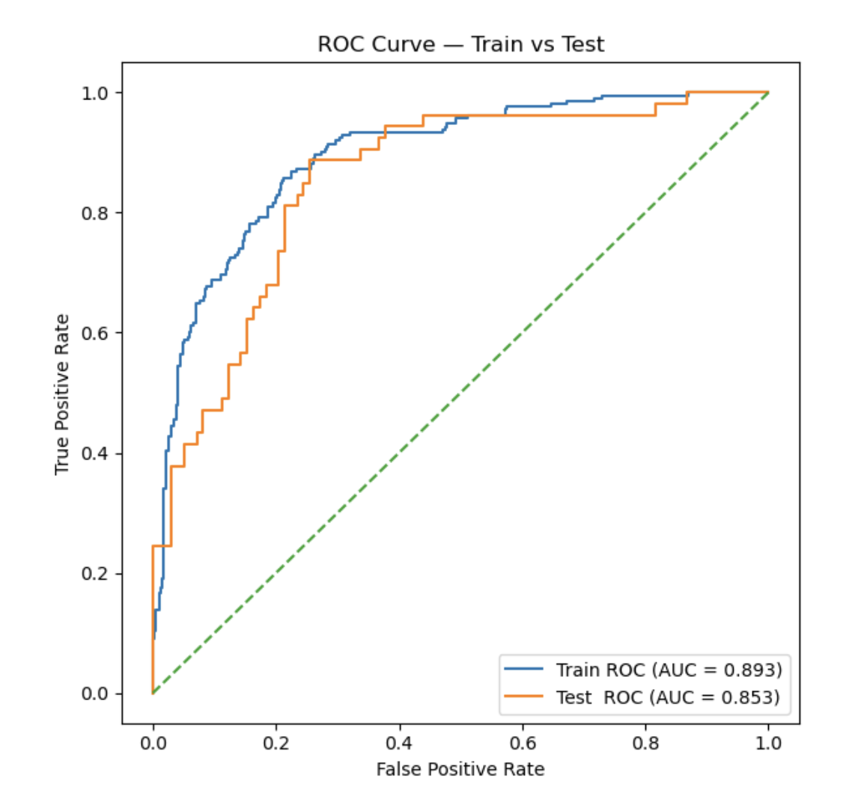
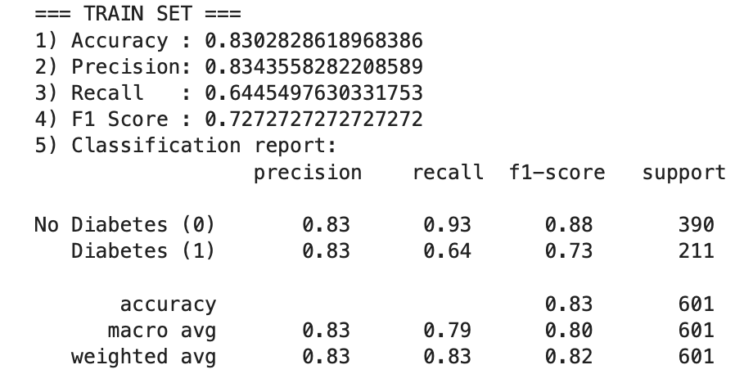
Group 2
Chapter 4 – Results, Analysis, Findings & Conclusion
4.2 Support Vector Machine (SVM) Results – Baseline Train: Train Set
Pipeline: RBF kernel + imputation + standard scaling
Accuracy: 83.0%
Precision: 83.4% | Recall: 64.5% | F1-score: 72.7%
ROC–AUC: 0.893
Presented By: Low Jia Hao 2302161

Slide 32
Group 2
Chapter 4 – Results, Analysis, Findings & Conclusion
4.2 Support Vector Machine (SVM) Results – Baseline Train: Test Set
Accuracy: 75.5%
Precision: 78.6% | Recall: 41.5% | F1-score: 54.3%
ROC–AUC: 0.853
Presented By: Low Jia Hao 2302161

Slide 33
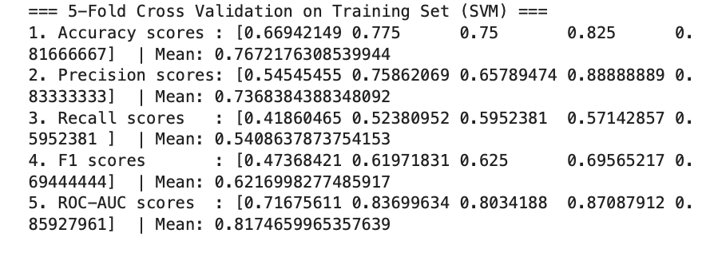
Group 2
Chapter 4 – Results, Analysis, Findings & Conclusion
4.2 Support Vevctor Machine (SVM) Results – Cross Validation: Train Set
Accuracy: 76.7%
Precision: 73.7% | Recall: 54.1% | F1-score: 62.2%
ROC–AUC: 0.817
Presented By: Low Jia Hao 2302161

Slide 34
Group 2
Chapter 4 – Results, Analysis, Findings & Conclusion
4.2 Support Vector Machine (SVM) Results – Hyperparameter Tuning (Training Set)
Accuracy: 77.9%
Precision: 72.9% | Recall: 58.8% | F1-score: 65.1%
ROC–AUC: 0.840
Best Parameters (GridSearchCV):
C: {1}
kernel: {'linear'}
gamma: {'scale'}
Presented By: Low Jia Hao 2302161

Slide 35
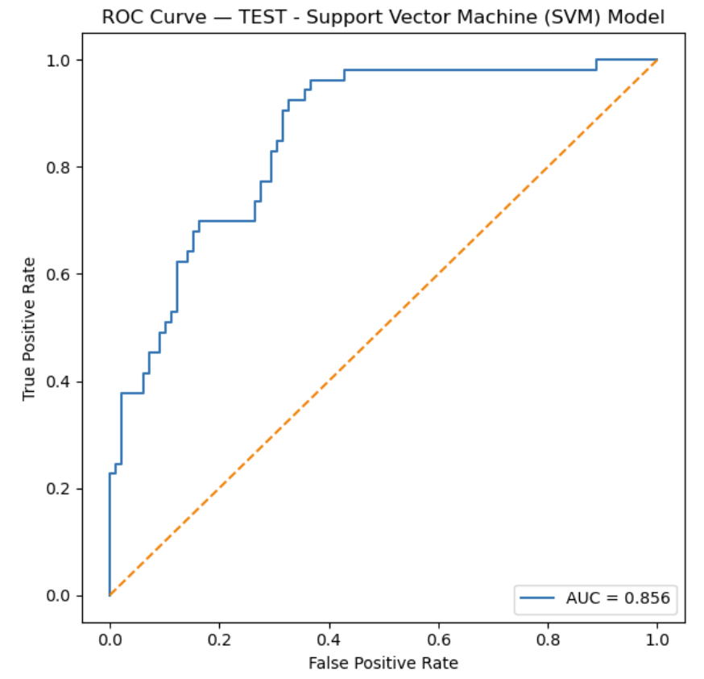
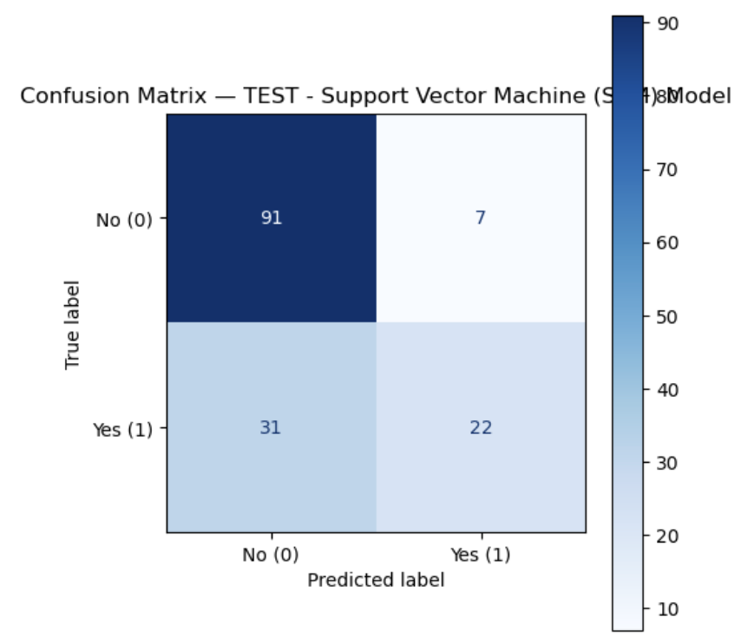
Group 2
Chapter 4 – Results, Analysis, Findings & Conclusion
4.2 Support Vector Machine (SVM) Results– Hyperparameter Tuning (Test Set)
Accuracy: 74.8%
Precision: 75.9% | Recall: 41.5% | F1-score: 53.7%
ROC–AUC: 0.856
Presented By: Low Jia Hao 2302161

Slide 36
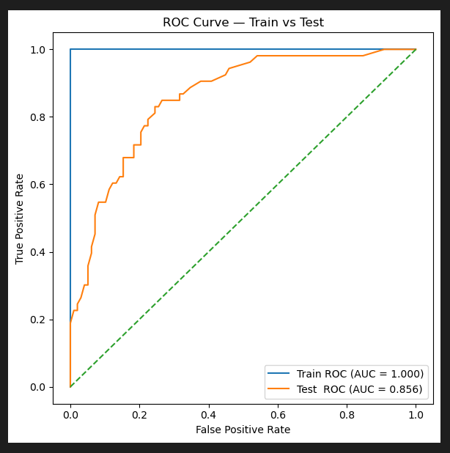
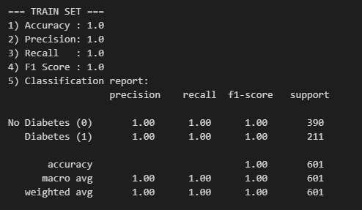
Group 2
Chapter 4 – Results, Analysis, Findings & Conclusion
4.3 Random Forest (RF) Results – Baseline Train: Train Set
Accuracy: 100%
Precision: 100% | Recall: 100% | F1-score: 100%
ROC–AUC: 1.000
Perfect performance on training set → Indicated overfitting risk
Model may not generalize well to unseen data.
Presented By: Loh Chia Heung 2301684

Slide 37
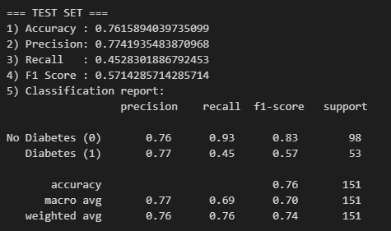
Group 2
Chapter 4 – Results, Analysis, Findings & Conclusion
4.3 Random Forest (RF) Results – Baseline Train: Test Set
Accuracy: 76.2%
Precision: 77.4% | Recall: 45.3% | F1-score: 57.1%
ROC–AUC: 0.856
Indicates overfitting: strong precision but weak recall
Model struggles to identify diabetic patients (minority class)
Presented By: Loh Chia Heung 2301684

Slide 38
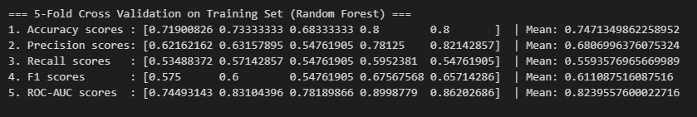
Group 2
Chapter 4 – Results, Analysis, Findings & Conclusion
4.3 Random Forest (RF) Results – Cross Validation: Train Set
Accuracy: 74.7%
Precision: 68.1% | Recall: 56.0% | F1-score: 61.1%
ROC–AUC: 0.824
Cross-validation gives more realistic performance estimates
Confirms overfitting in baseline training (100%) was misleading
Presented By: Loh Chia Heung 2301684

Slide 39
Group 2
Chapter 4 – Results, Analysis, Findings & Conclusion
4.3 Random Forest (RF) Results – Hyperparameter Tuning (Training Set)
Accuracy: 90.5%
Precision: 82.6% | Recall: 92.4% | F1-score: 87.2%
ROC–AUC: 0.975
Show major improvement compared to baseline & CV
High recall → Better at detecting diabetic cases
Best Parameters (GridSearchCV):
n_estimators: 100
max_depth: 10
min_samples_split: 2
min_samples_leaf: 4
max_features: "sqrt"
Presented By: Loh Chia Heung 2301684

Slide 40
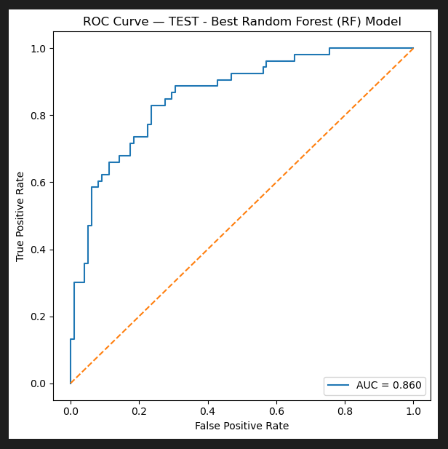
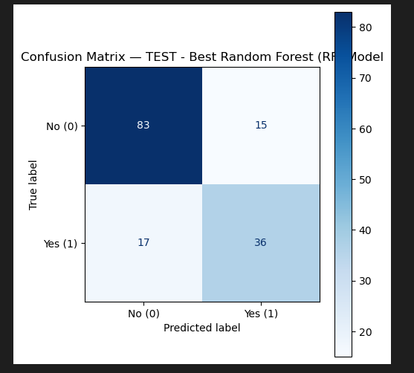
Group 2
Chapter 4 – Results, Analysis, Findings & Conclusion
4.3 Random Forest (RF) Results – Hyperparameter Tuning (Test Set)
Accuracy: 78.8%
Precision: 70.6% | Recall: 67.9% | F1-score: 69.2%
ROC–AUC: 0.860
Performance improved compared to baseline test set (76.2% accuracy, 45.3% recall)
Higher recall → better detection of diabetic patients
Balanced trade-off between precision and recall
ROC–AUC confirms strong discriminative ability
Presented By: Loh Chia Heung 2301684

Slide 41
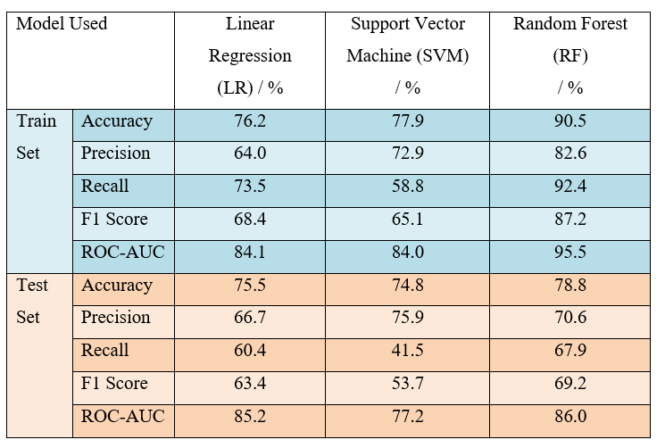
Group 2
Chapter 4 – Results, Analysis, Findings & Conclusion
1. Logistic Regression (LR):
Balanced performance on train & test
Test recall = 60.4% → moderate detection of diabetic cases
4.4 Model Comparison
2. Support Vector Machine (SVM):
Highest test precision = 75.9% (avoids false positives)
Very low recall = 41.5% → misses many diabetic patients
3. Random Forest (RF):
Highest train accuracy (90.5%) & recall (92.4%)
Best test recall = 67.9%, F1 = 69.2%, ROC–AUC = 86.0%
Most balanced trade-off between accuracy, precision, and recall
Presented By: Loh Chia Heung 2301684

Slide 42
Group 2
Chapter 4 – Results, Analysis, Findings & Conclusion
4.4 Model Comparison (Cont.)
Conclusion:
Best Model: Random Forest (RF)
RF provides stronger generalization and higher recall, which is critical in healthcare to minimize the false negatives.
Presented By: Loh Chia Heung 2301684

Slide 43

Group 2
Thank You For Attention!

